Slide 1

Installing and running xMWAS
Karan Uppal, PhD
Assistant Professor of Medicine
Director of Computational Metabolomics & Integrative Omics, Clinical Biomarkers Laboratory
Emory University
Email: kuppal2@emory.edu
Last updated: July 17, 2019

Slide 2
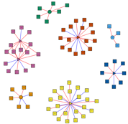
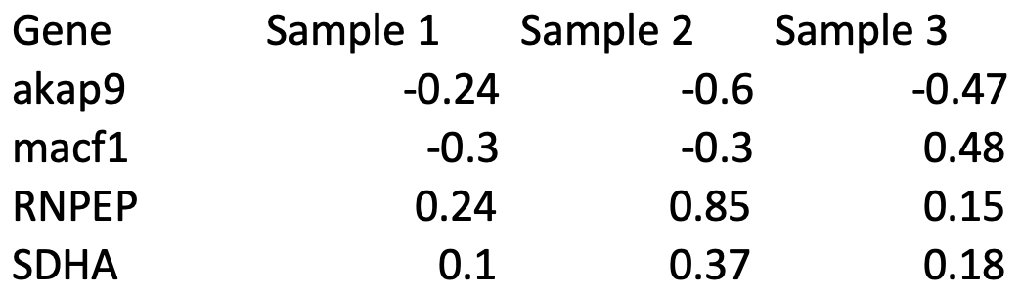
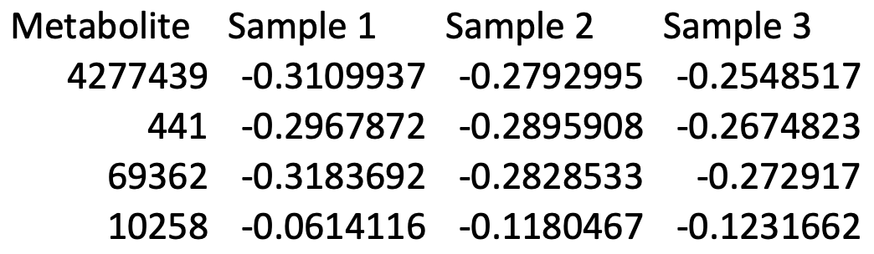
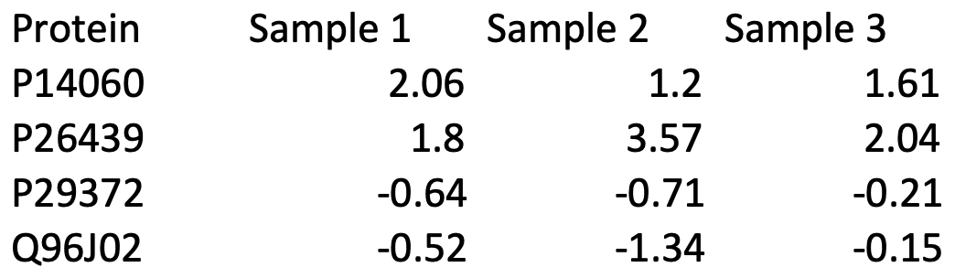
xMWAS: a data-driven integration and differential network analysis (Uppal 2018, Bioinformatics) URL: https://kuppal.shinyapps.io/xmwas/ R package: https://github.com/kuppal2/xMWAS
Transcriptomics
Metabolomics
Proteomics
Pairwise (sparse) Partial Least Squares regression for data integration (Cao 2009)
Approximation of Pearson correlation using PLS components
Filtering based on |r|>threshold and p-value<alpha criteria
Community (clusters) detection and
centrality (importance) analysis
Genes
Proteins
Metabolites
Positive correlation
Negative correlation

Slide 3
Software availability
R package: https://github.com/kuppal2/xMWAS
Example R scripts:
https://github.com/kuppal2/xMWAS/tree/master/example_manual_tutorial
R shiny app locally on your laptop/desktop (new feature):
library(xMWAS)
launchShinyApp()
Basic web version: https://kuppal.shinyapps.io/xmwas/
User manual
https://github.com/kuppal2/xMWAS/blob/master/example_manual_tutorial/xMWAS-manual.pdf

Slide 4
xMWAS installation instructions for Windows
(Prerequisite: install R https://cran.cnr.berkeley.edu/)
Launch R. Copy and paste the following command in R terminal to install dependencies
if (!requireNamespace("BiocManager", quietly = TRUE))
install.packages("BiocManager"); BiocManager::install("BiocInstaller", version = "3.8")
#For R > 3.5.0
BiocManager::install(c("GO.db","graph","RBGL","impute","preprocessCore","mixOmics"),dependencies=TRUE);
#For R < 3.5.0
biocLite(c("GO.db","graph","RBGL","impute","preprocessCore","mixOmics"),dependencies=TRUE);
install.packages(c("devtools","WGCNA", "snow","igraph","plyr","plsgenomics", "shiny","shinyBS","visNetwork"),dependencies=TRUE,type="binary", repos=http://cran.r-project.org)
Copy and paste the following command in R terminal to install xMWAS:
library(devtools); install_github("kuppal2/xMWAS")
Copy and paste the following command in R terminal to test the installation:
library(xMWAS)

Slide 5
xMWAS installation - Mac OS X
Prerequisites:
Install R https://cran.cnr.berkeley.edu/
Install Xquartz: https://www.xquartz.org/
Launch R. Copy and paste the following commands in R terminal to install dependencies
if (!requireNamespace("BiocManager", quietly = TRUE))
install.packages("BiocManager"); BiocManager::install("BiocInstaller", version = "3.8")
#For R > 3.5.0
BiocManager::install(c("GO.db","graph","RBGL","impute","preprocessCore","mixOmics"),dependencies=TRUE);
#For R < 3.5.0
biocLite(c("GO.db","graph","RBGL","impute","preprocessCore","mixOmics"),dependencies=TRUE);
install.packages(c("devtools","WGCNA", "snow","igraph","plyr","plsgenomics", "shiny","shinyBS","visNetwork"),dependencies=TRUE, repos="http://cran.r-project.org")
Copy and paste the following command in R terminal to install xMWAS:
library(devtools); install_github("kuppal2/xMWAS”)
Copy and paste the following command in R terminal to test the installation:
library(xMWAS)

Slide 6
Running xMWAS
Three options:
Launching the Shiny App using R/RStudio
Running the R script using R/Rstudio
Using the website (only supports 1-2 users at a time): https://kuppal.shinyapps.io/xmwas/

Slide 7
1. xMWAS: launching the shiny app locally using R
Option A: directly from GitHub; runs the latest version on GitHub
(#copy and paste the commands in green in R)
library(shiny)
shiny::runGitHub('xMWAS', 'kuppal2',subdir="inst/shinyapp/")
Option B: launch from within xMWAS version installed on the computer
library(xMWAS)
launchShinyApp()

Slide 8
Input data format (more details under “Help and Support”)
Metabolomics data
(p metabolites x n subjects)
Class labels file
 | Subject1 | Subject2 | - | Subject N
Metabolite 1 | 199 | 19 | - | 100
Metabolite 2 | 10 | 40 |  | 90
- | - | - |  | -
Metabolite p | 50 | 30 | - | 20
 | Class
Subject1 | Control
Subject2 | Control
- | -
SubjectN-1 | Tumor
SubjectN | Tumor
Transcriptomics data
(q genes x n subjects)
 | Subject1 | Subject2 | - | Subject N
Gene 1 | 19 | 19 | - | 100
Gene 2 | 10 | 40 | - | 90
- | - | - | - | -
Gene q | 10 | 40 | - | 50

Slide 9
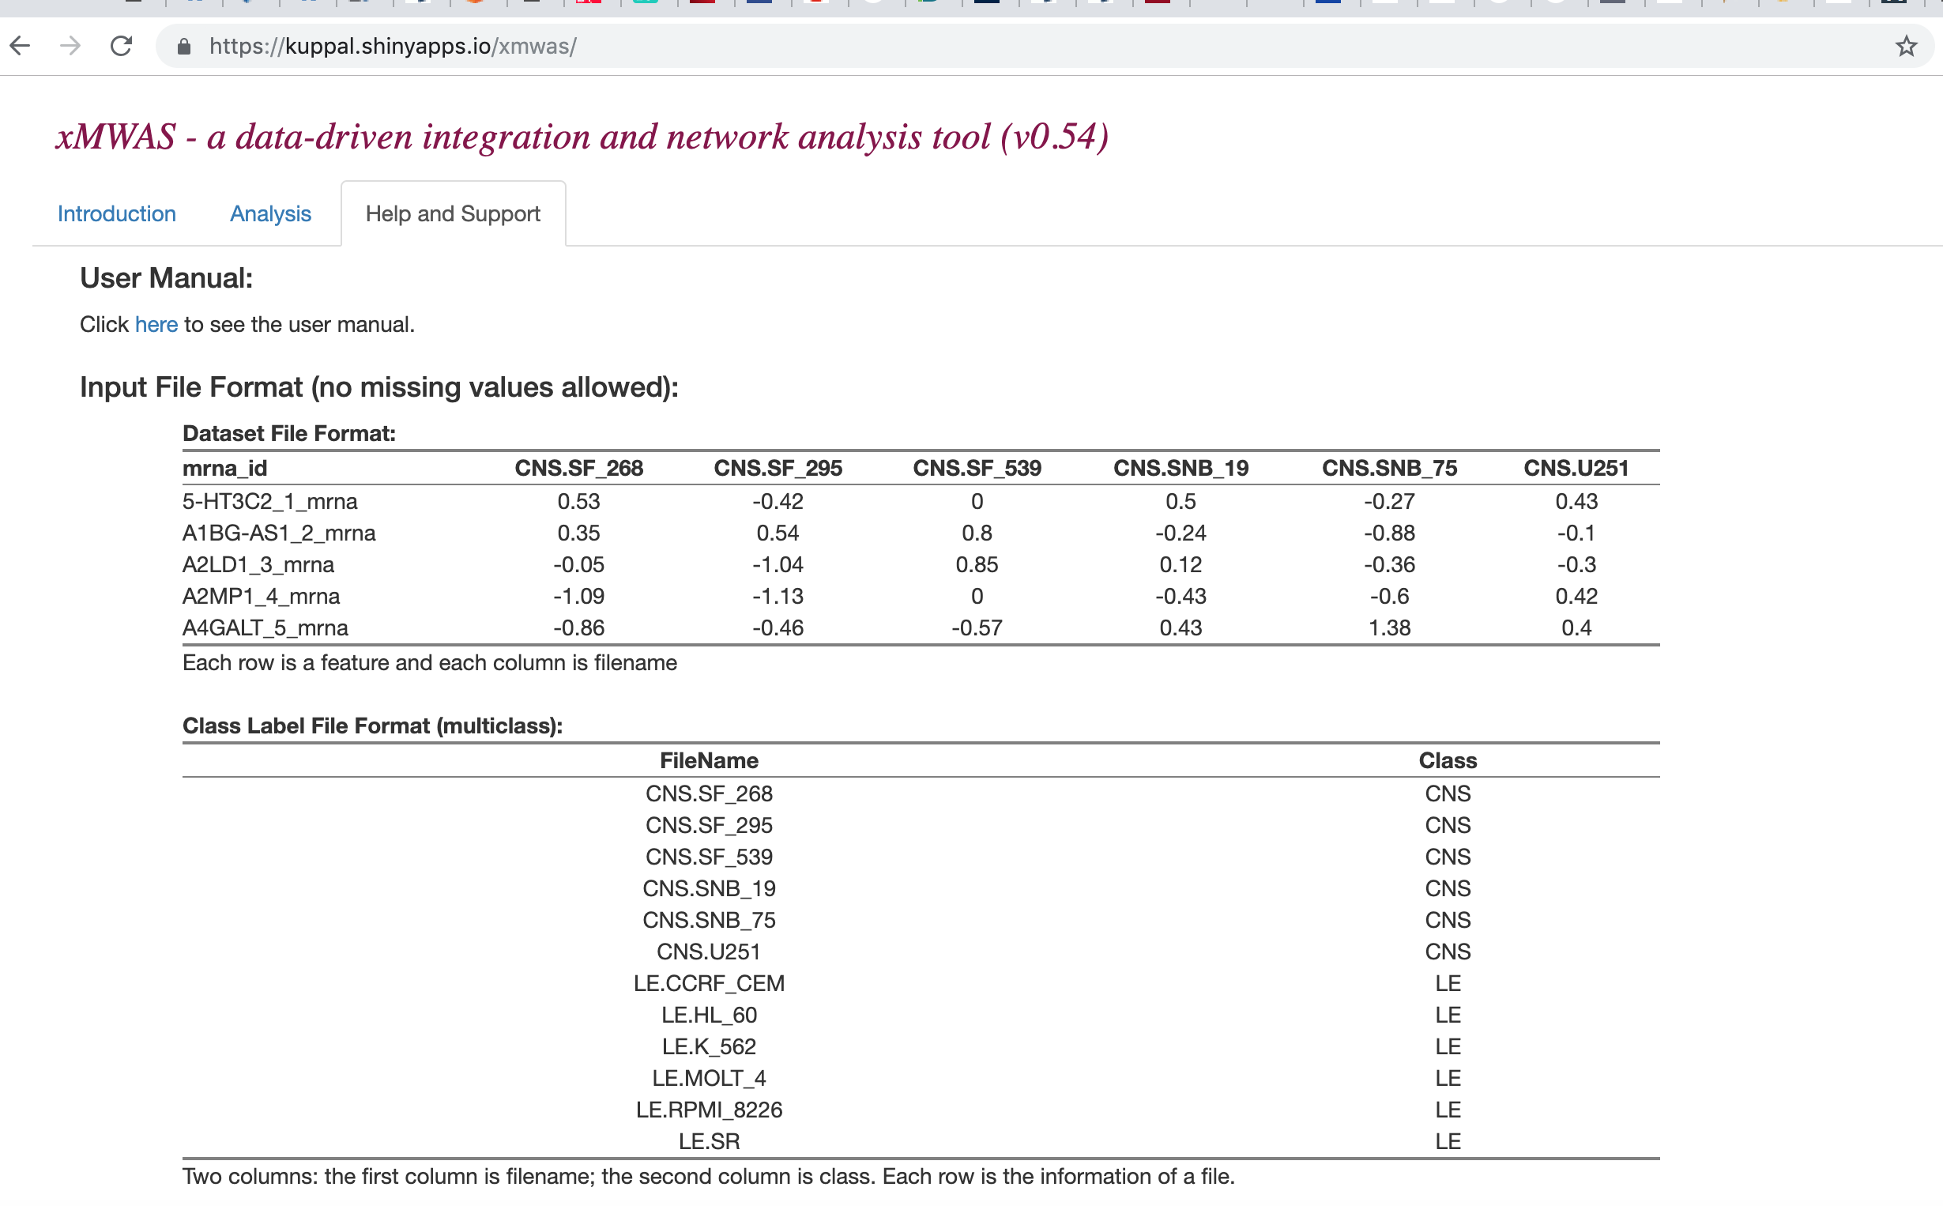
Help and Support page

Slide 10
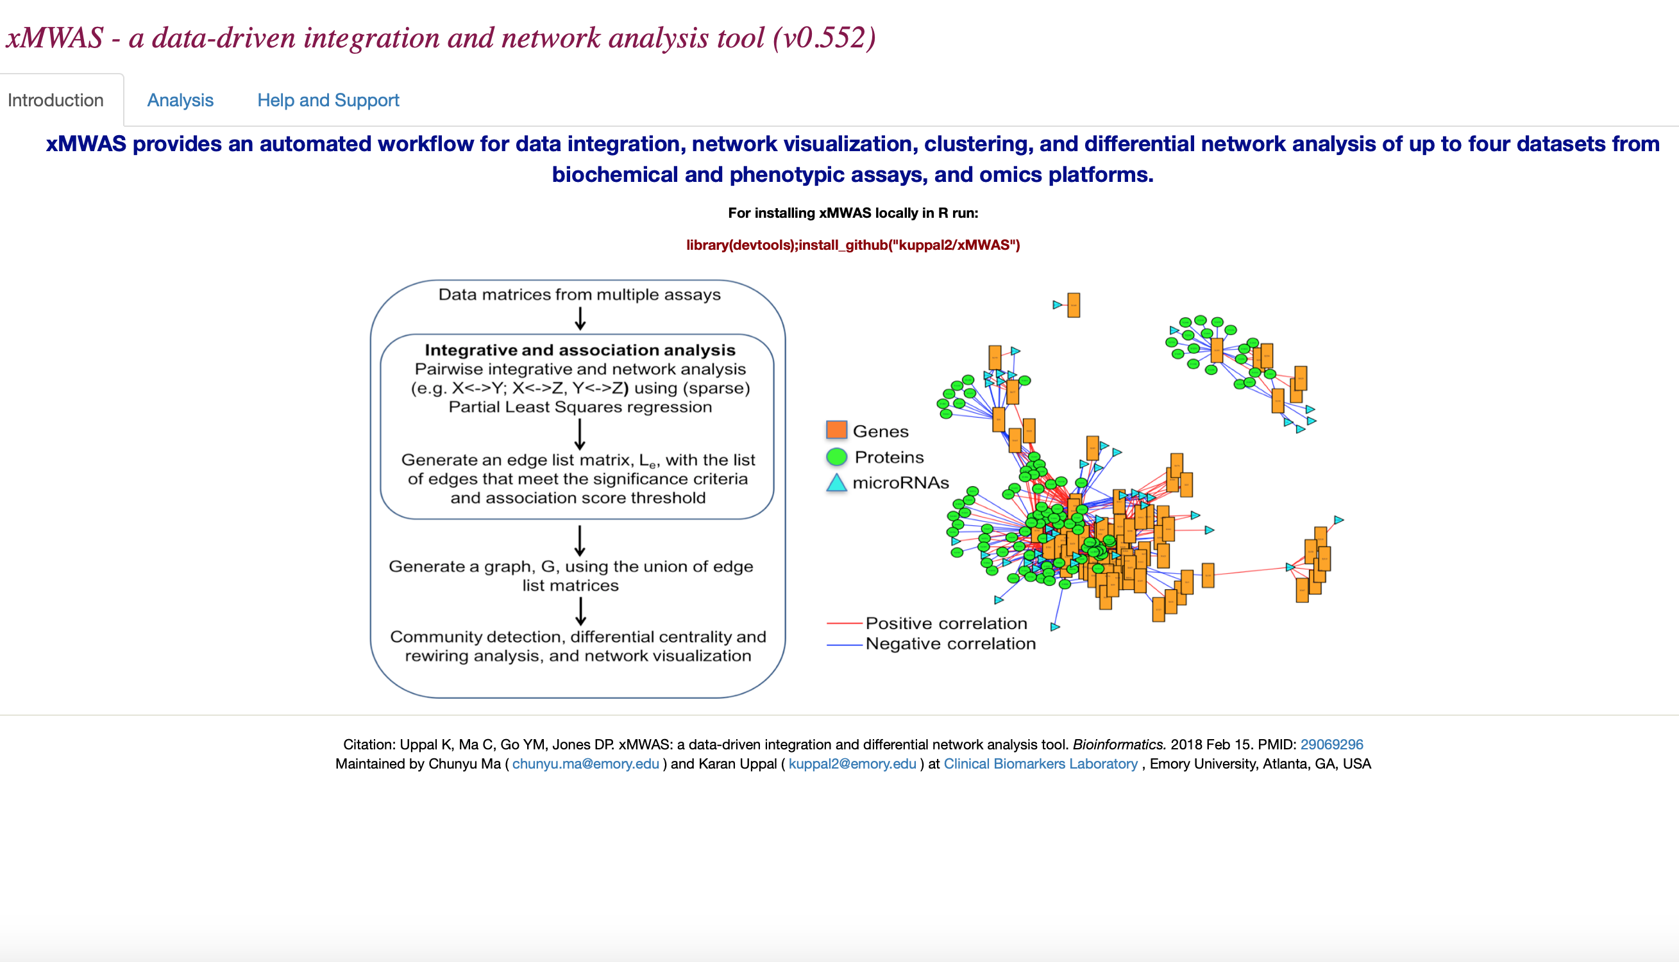
xMWAS: Home Page

Slide 11
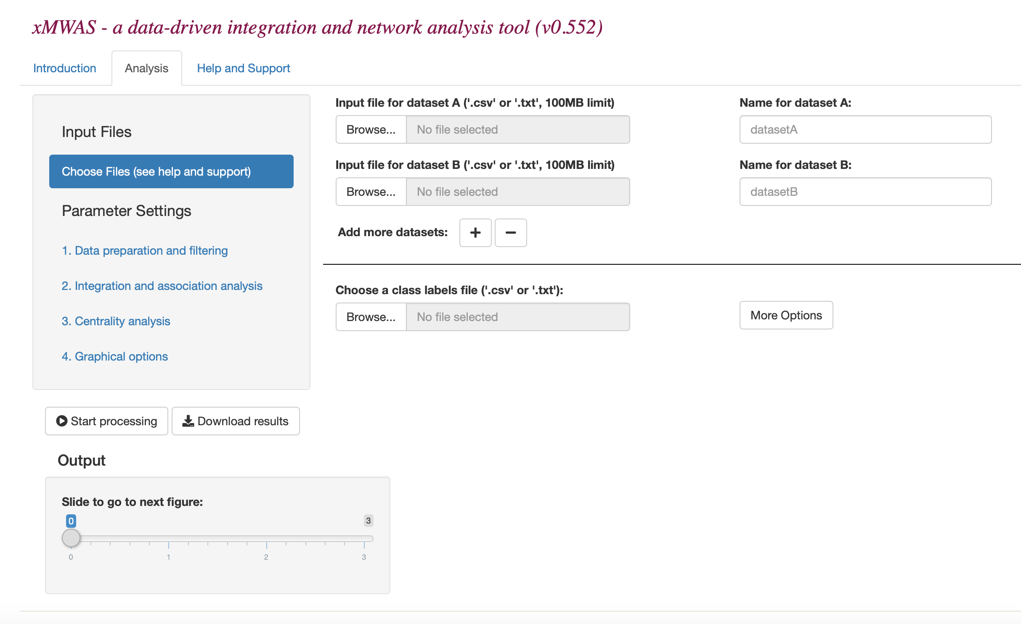
Step 1. Upload data files
Example input files: https://github.com/kuppal2/xMWAS/upload/master/example_manual_tutorial
exh1n1_transcriptome.txt
exh1n1_metabolome.txt
exh1n1_cytokine.txt
exh1n1_classlabels.txt
(See: Help & Support)

Slide 12
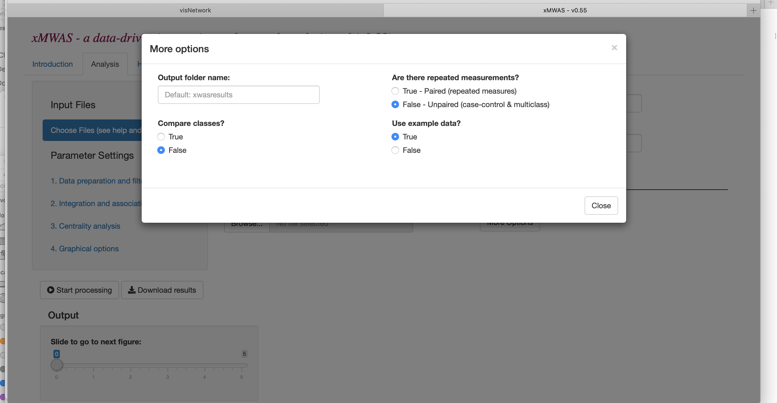
Use example dataset (click on “More options” -> set Use example data to “True”)

Slide 13
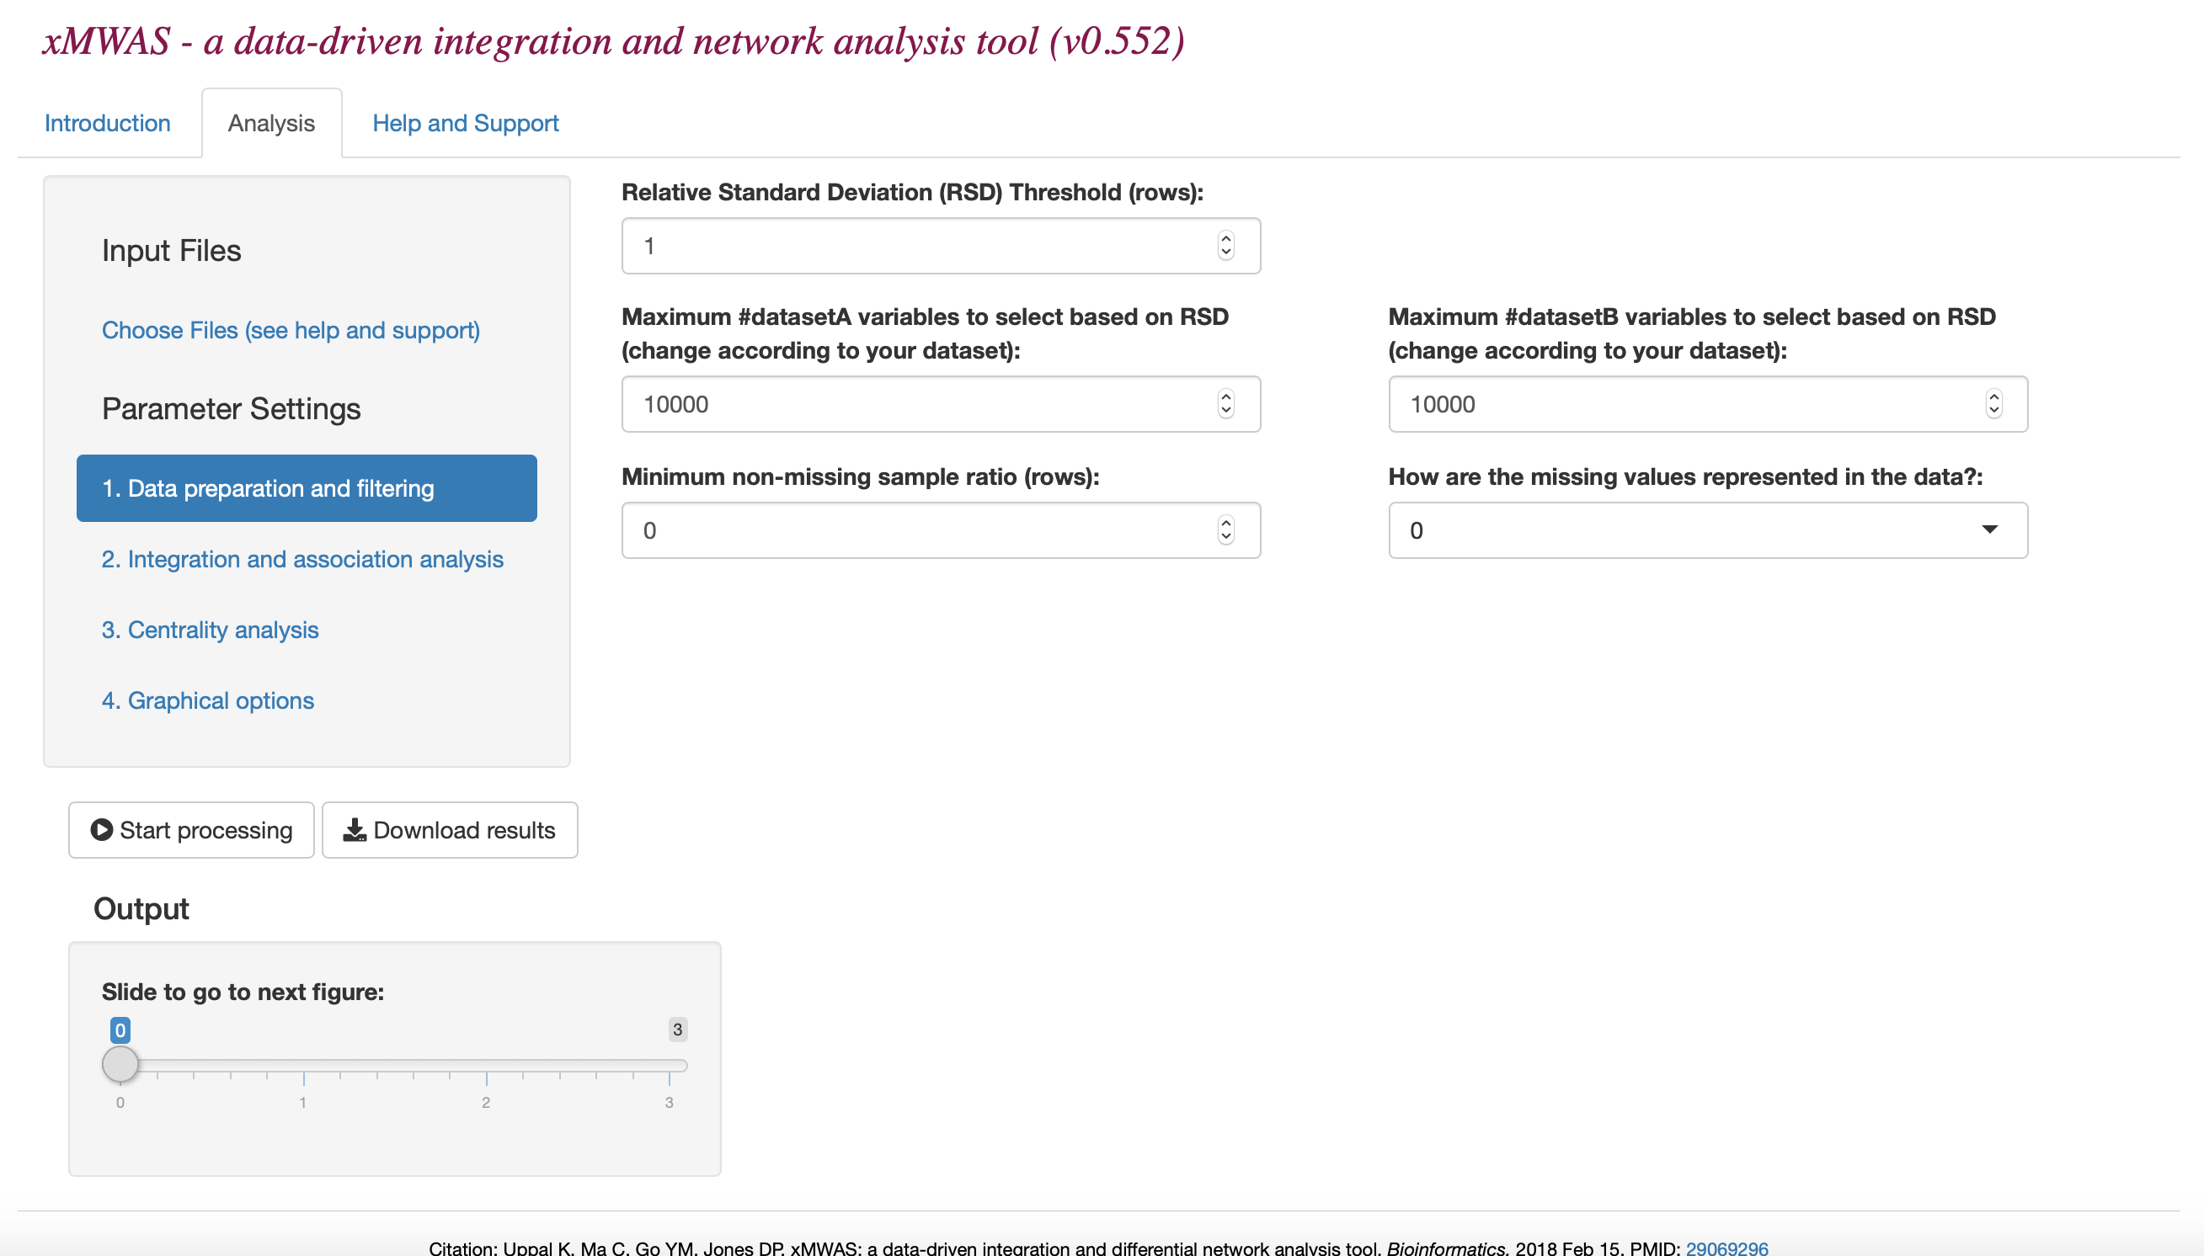
Step 2. Data preprocessing and filtering
https://github.com/kuppal2/xMWAS/blob/master/example_manual_tutorial/xMWAS-manual.pdf

Slide 14
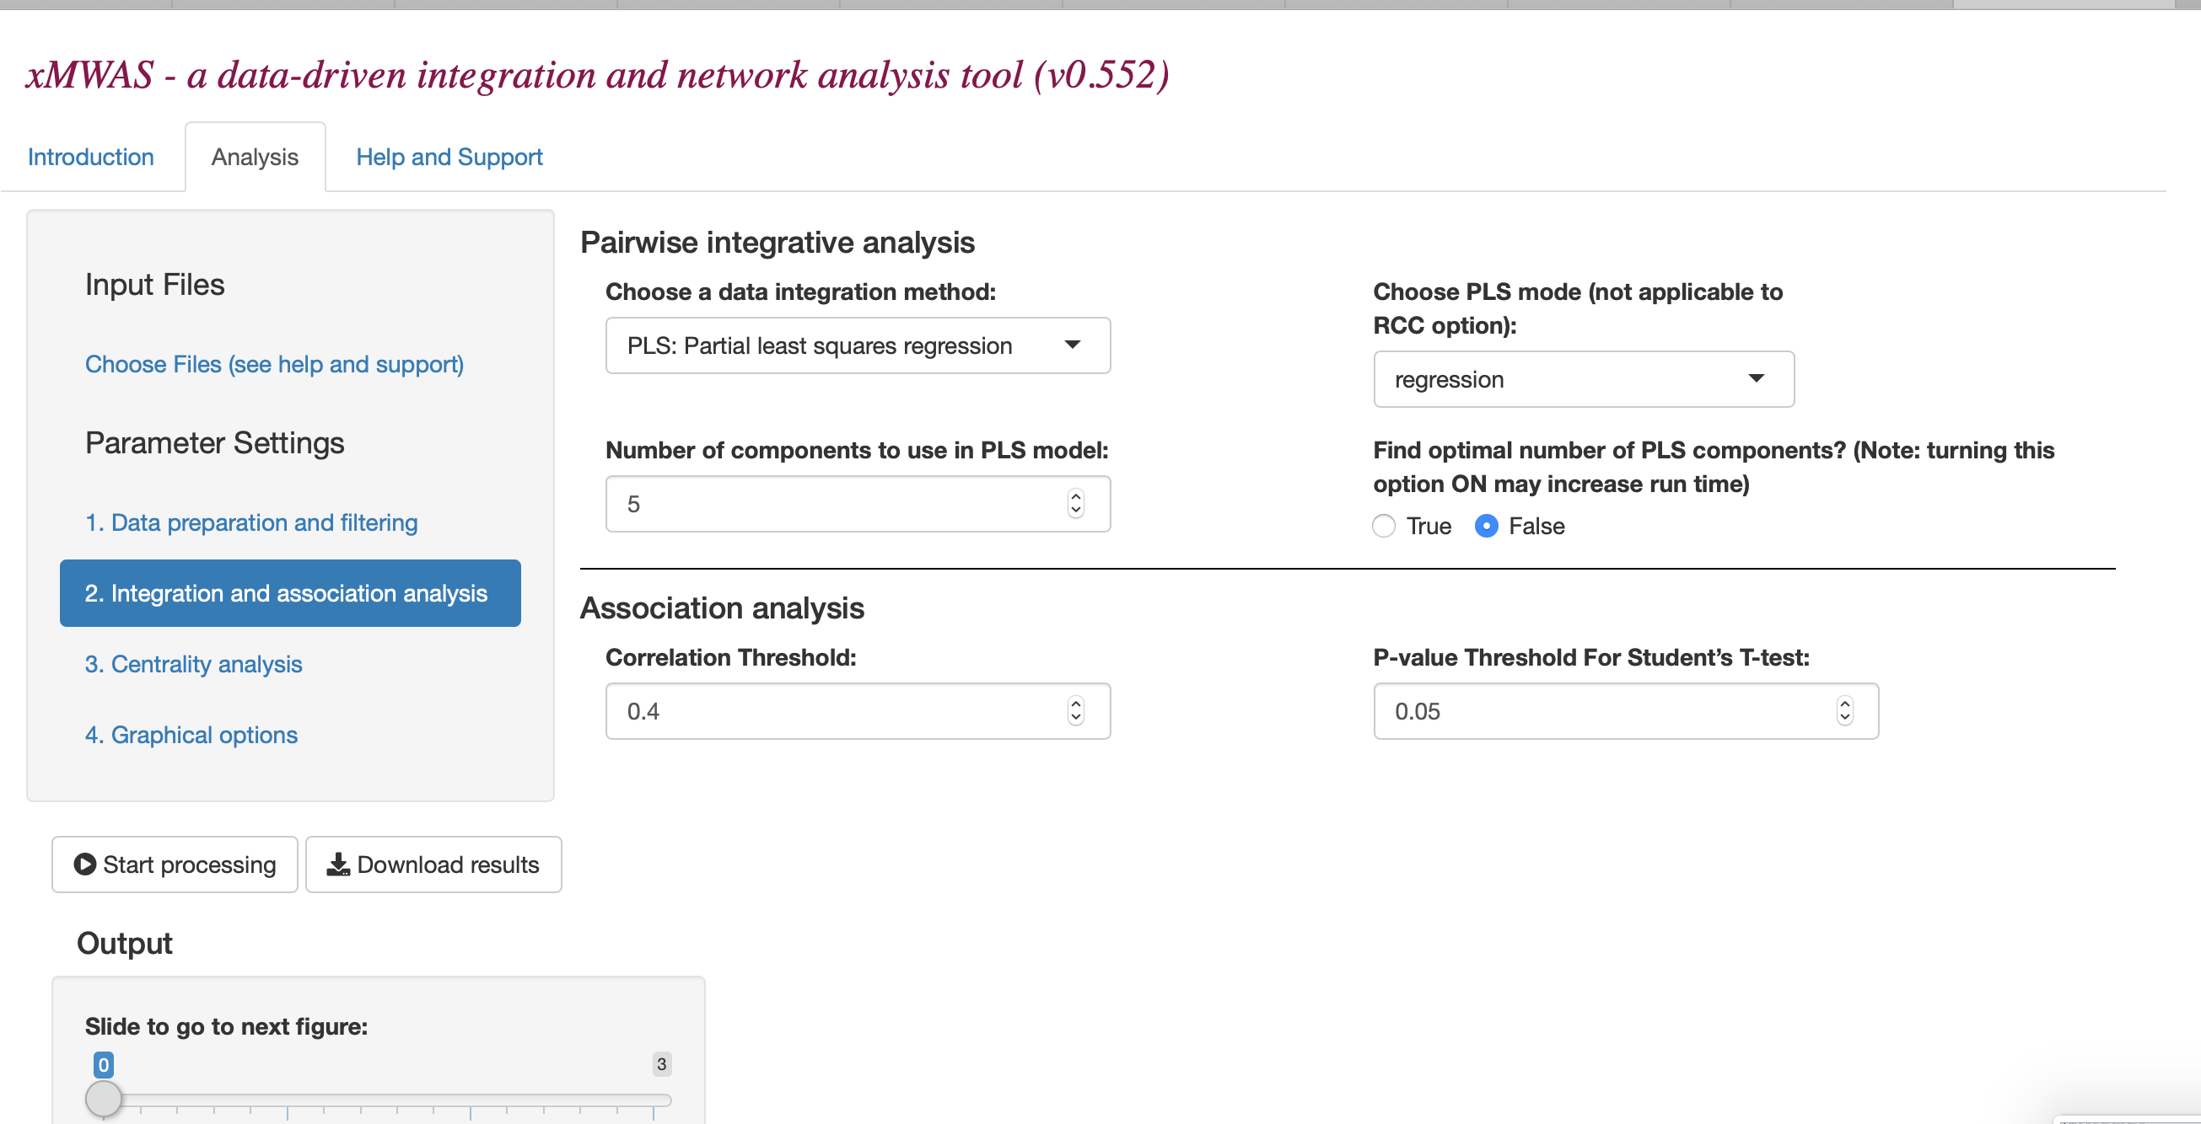
Step 3. Set parameters for integration and association analysis
https://github.com/kuppal2/xMWAS/blob/master/example_manual_tutorial/xMWAS-manual.pdf

Slide 15
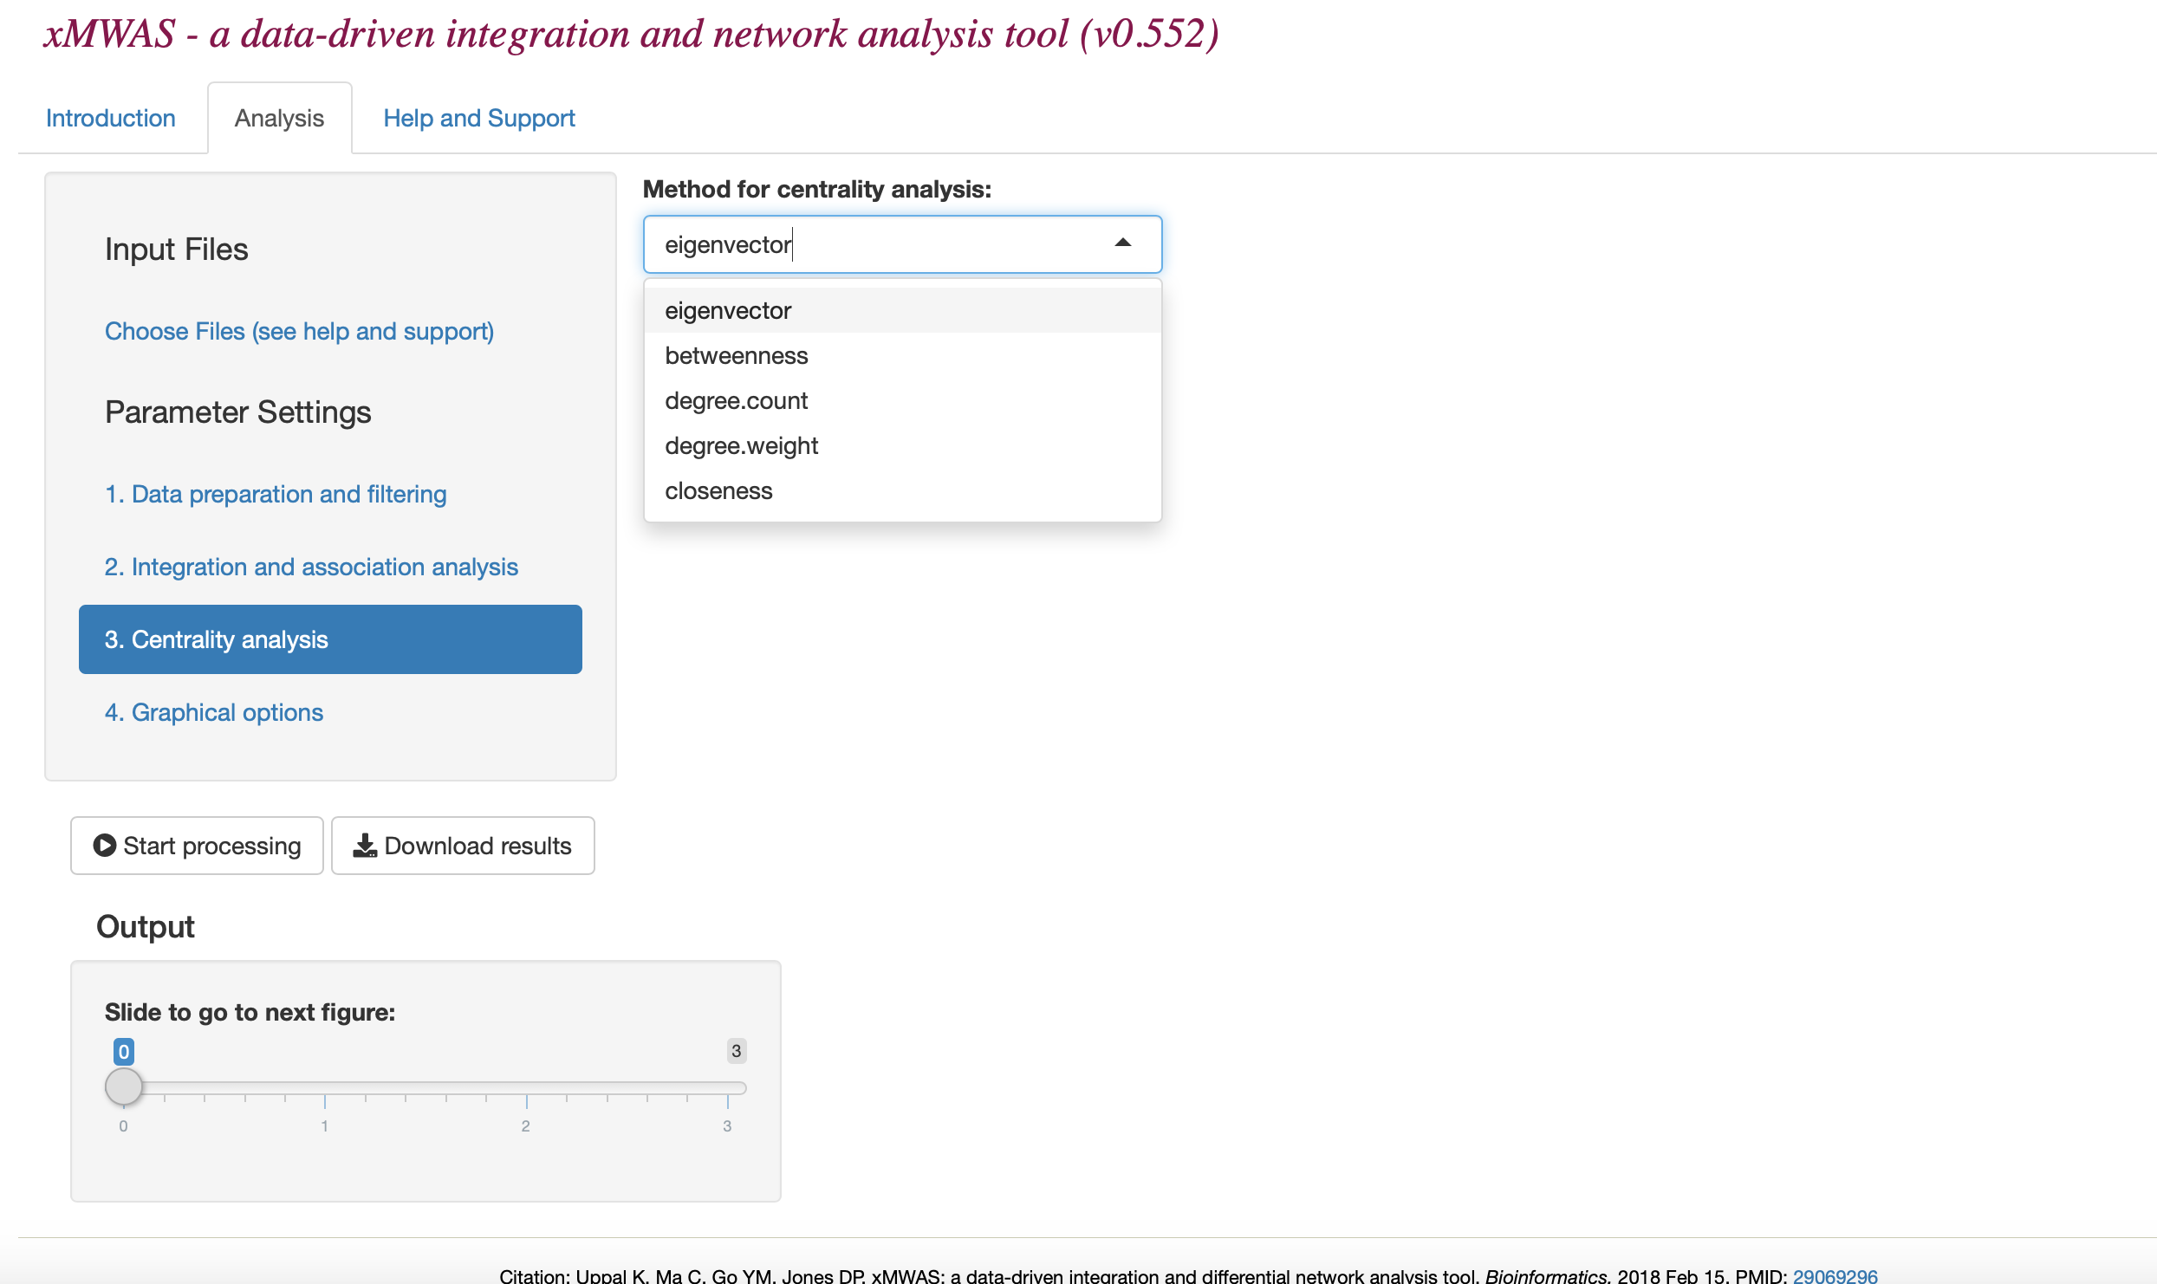
Step 4. Select method for centrality analysis
Eigenvector: based on the number and quality of connections
Betweenness: based on the extent to which a node lies on
the path between other nodes
Degree.count: based on the number of connections
Degree.weight: based on the magnitude of edges (association
scores)
Closeness: based on the closeness of a node to all other nodes

Slide 16
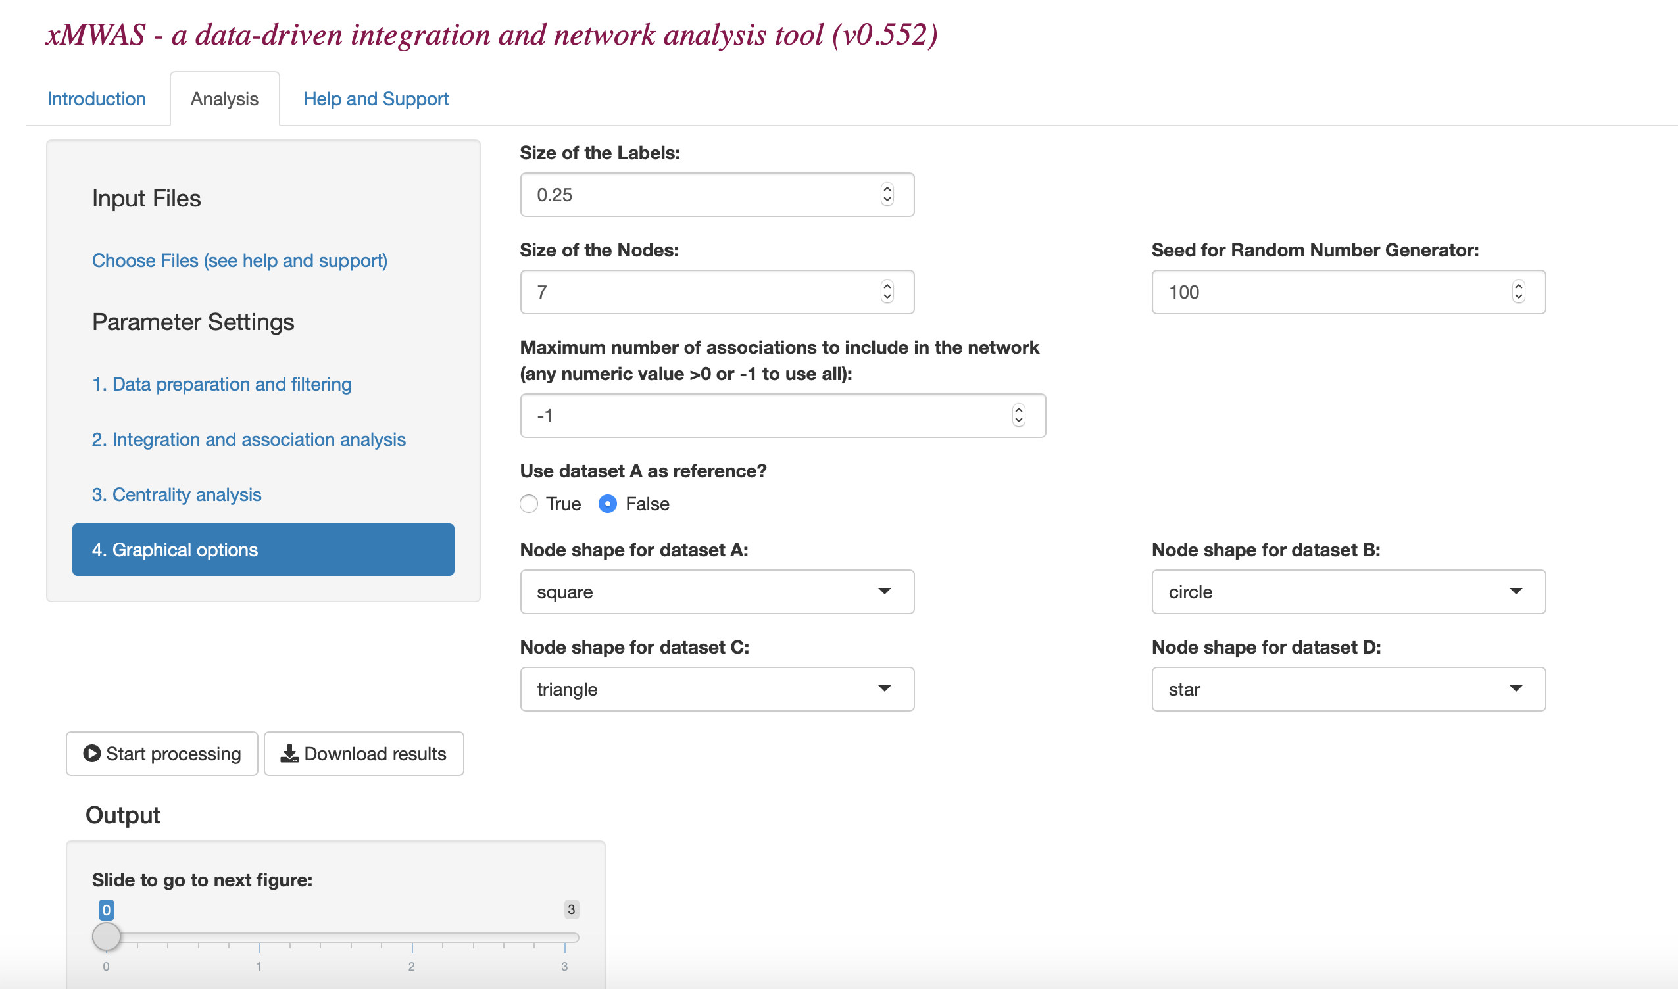
Step 5. Set “Graphical Options”

Slide 17
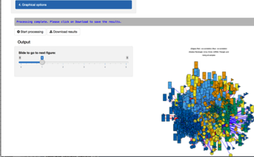
Step 6. Click on “Start processing”
You will see the network plots as output
and the message:
“Processing complete. Please
Click on Download to save the results” once
the processing is complete.

Slide 18
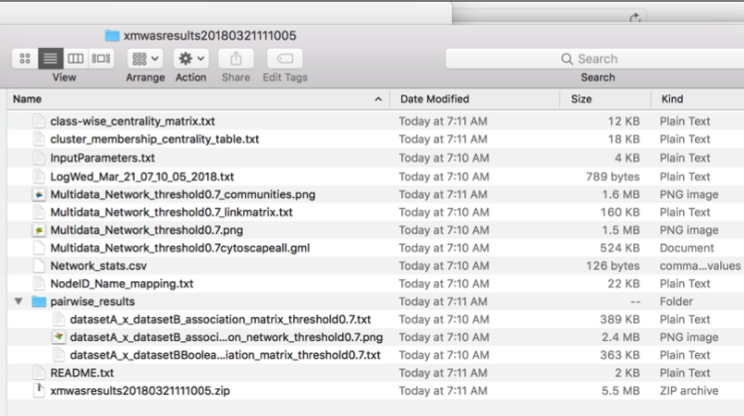
Download results

Slide 19
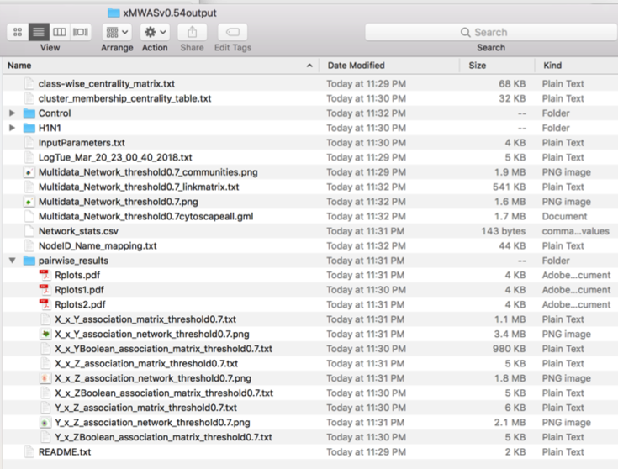
xMWAS output

Slide 20
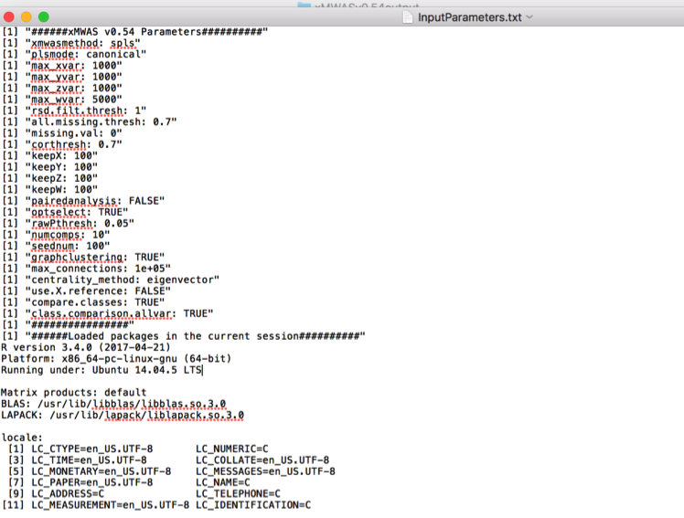
Input Parameters

Slide 21
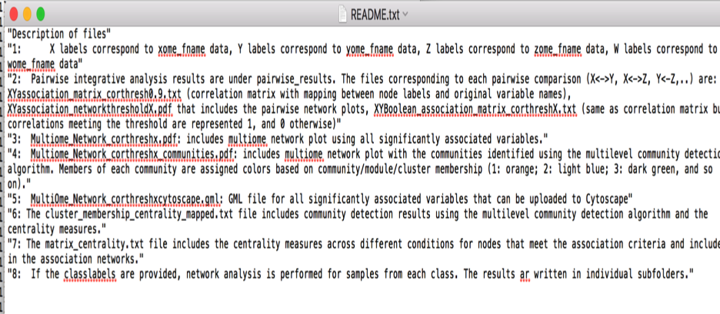
Description of output: Readme.txt

Slide 22
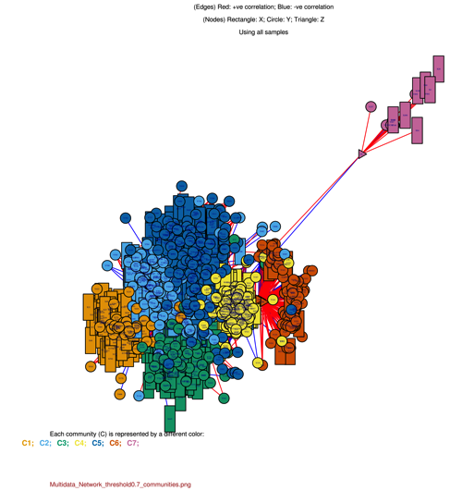
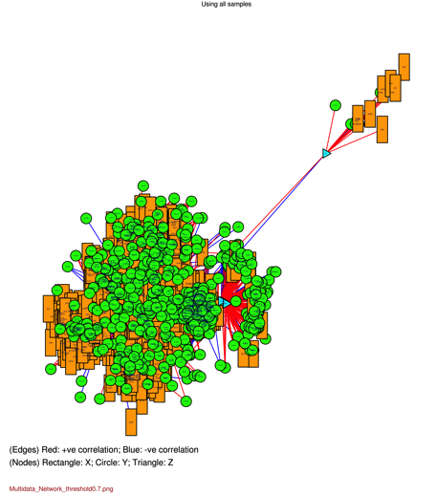
Network graphs
Colored by data type
B. Colored by community membership
Metabolites
Genes
Cytokines
Positive correlation
Negative correlation

Slide 23
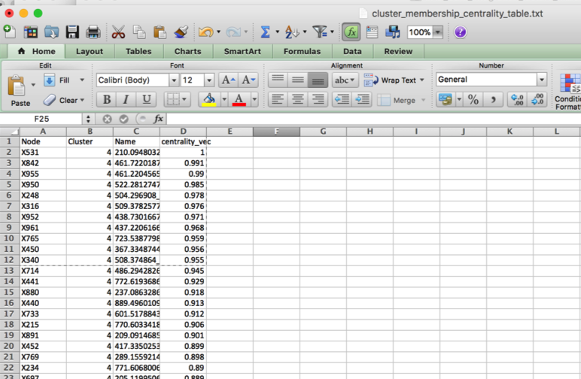
Community detection and centrality analysis

Slide 24
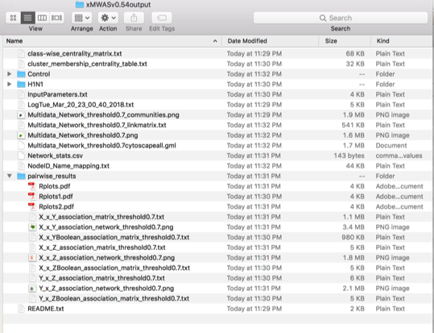
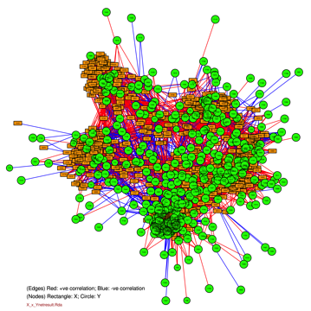
Pairwise results – X<->Y, X<->Z, Y<->Z

Slide 25
2. Running the R script
URL for example R script: https://github.com/kuppal2/xMWAS/blob/master/example_manual_tutorial/example_xmwas_runscript_v0.55.R
User manual with description of arguments:
https://github.com/kuppal2/xMWAS/blob/master/example_manual_tutorial/xMWAS-manual.pdf

Slide 26
R script for xMWAS using the example dataset (URL: https://github.com/kuppal2/xMWAS/blob/master/example_manual_tutorial/example_xmwas_runscript_v0.55.R)
#load package
library(xMWAS)
#example dataset that includes metabolome, transcriptome, and cytokine data from the H1N1 mice study (Chandler 2016)
data(exh1n1)
data(classlabels_casecontrol) #example classlabels file for case vs control design
data(classlabels_repeatmeasures) #example classlabels file for repeat measures design
#dataX<-read.table("/Users/karanuppal/featuretable_xMWASp0.05.txt",sep="\t",header=TRUE,row.names=1)
#dataY<-read.table("/Users/karanuppal/UntargetLipids_xMWASp0.05.txt",sep="\t",header=TRUE,row.names=1)
#dataZ<-read.table("/Users/karanuppal/TargetedLipids_v2.txt",sep="\t",header=TRUE,row.names=1)
#classlabels<-read.table("/Users/karanuppal/classlabels.txt",sep="\t",header=TRUE)
xMat<-exh1n1$metabolome
yMat<-exh1n1$transcrlptome
zMat<-exh1n1$cytokine
classlabels<-exh1n1$classlabels
output<-"/home/kuppal2/xMWASv0.55output/"
#call the run_xmwas() function:
xmwas_res<-run_xmwas(Xome_data=xMat,Yome_data=yMat,Zome_data=zMat,Wome_data=NA,outloc=output, classlabels=classlabels,class_fname=NA,xmwasmethod="pls",plsmode="regression",max_xvar=10000,max_yvar=10000, max_zvar=10000,max_wvar=10000,rsd.filt.thresh=1,corthresh=0.4,keepX=1000,keepY=1000,keepZ=1000,keepW=1000, pairedanalysis=FALSE,optselect=TRUE,rawPthresh=0.05,numcomps=10,net_edge_colors=c("blue","red"), net_node_colors=c("orange", "green","cyan","pink"),Xname="X",Yname="Y",Zname="Z",Wname="W", net_node_shape=c("square","circle","triangle","star"),all.missing.thresh=0,missing.val=0, seednum=100,label.cex=0.2,vertex.size=6,max_connections=NA, centrality_method="eigenvector",use.X.reference=FALSE,removeRda=TRUE,compare.classes=TRUE,class.comparison.allvar=TRUE)
suppressWarnings(try(sink(file=NULL),silent=TRUE))

Slide 27
xMWAS output

